Slide 1
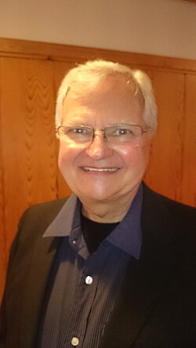
Bruce Olson
Born in 1941 in Minnesota
Left college at 19 for South America
Went alone to the Motilone tribe
The tribe named him “Bruchko”
Lived and worked with them for decades
“Bruchko” — missionary to the Motilone people of Colombia
Notes:
Bruce Olson is an American missionary born in 1941 in Minnesota. At 19 he left college and went to South America on his own, with no mission group behind him, to reach the Motilone (Barí) people on the Colombia–Venezuela border. They gave him the name Bruchko.

Slide 2
Winning their trust
1
2
3
4
5
The Motilone attacked outsiders
He was shot in the leg with an arrow
He learned their language and way of life
He became close friends with a man named Bobby
He shared his faith using their own culture
Notes:
The Motilone were known for attacking outsiders, including oil company workers on their land. On one early attempt, a tribe member shot Olson in the leg with an arrow. He stayed, learned their language and lived like them. His friendship with a Motilone man named Bobarishora, or Bobby, was the turning point. He explained Christianity using ideas from their own culture instead of forcing outside ways on them.

Slide 3





What he accomplished
Wrote down the Barí language
Started schools taught in their language
Opened medical clinics
Trained the Motilone to run them
Spoke up for them to Colombia’s leaders and the UN
Notes:
Olson wrote down the Barí language so the people could read and write it. At the elders' request he set up jungle schools in their own language, plus medical clinics and literacy programs. He trained the Motilone to run these themselves, which he called the Motilone Miracle. He became a Colombian citizen in 1988, was friends with four Colombian presidents, and spoke at the United Nations.

Slide 4





Kidnapping and legacy
Kidnapped
Legacy
9 months
Captured by ELN guerrillas in 1988
His book Bruchko sold 300,000+ copies
Sentenced to death, then freed in 1989
Critics ask if outsiders should change tribal cultures
held captive by ELN guerrillas, 1988–89
The Motilone people defended him
Notes:
On October 24, 1988, ELN guerrillas captured Olson because he would not cooperate with them. Their court sentenced him to death. The Motilone stood up for him, and after about nine months public pressure got him released in 1989. His book Bruchko has sold over 300,000 copies. Supporters see him as a model for respecting local culture, but critics, like a 1981 book called Missionary or American Colonizer?, question whether outsiders should change tribal ways of life.

